Slide 1
Online Shopper Purchasing Intent
- Final Report
Brock Ricker
05/15/2022

Slide 2
About the Data
Exploratory Analysis
Customer Segmentation
Modeling

Slide 3
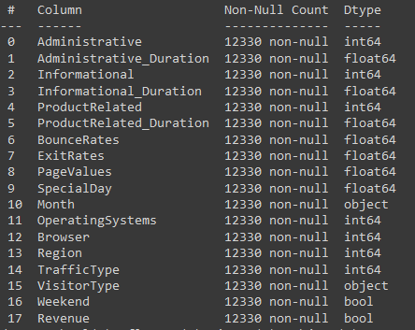
About the Data
Context
Consists of 12,330 online shopping “sessions”
Each session is unique, and data covers a 1 year period
Content
Target = “Revenue”
Did the session end in the customer purchasing something
10 numerical, and 7 categorical features
Three types of web pages: Administrative, Informational, Product
2 features per page type, 1 for number of pages visited and 1 for duration spent on these pages
i.e. “Administrative” and “Administrative Duration”
Three features from google analytics
Bounce Rate
Exit Rate
Page Value

Slide 4
About the Data cont..
Content cont…
Three features based on time of session
Special Day – closeness to a specific holiday (Xmas, mother’s day, etc..)
Month – Month of the year
Weekend – Weekend yes/no
Two features based on the customer’s PC
Operating System
Browser
Customer location (region)
Traffic type
Visitor type
Returning visitor, new visitor, other
Data processing required
Data was received clean and ready to use
Boolean features converted to 1/0 integer columns for ease of use

Slide 5
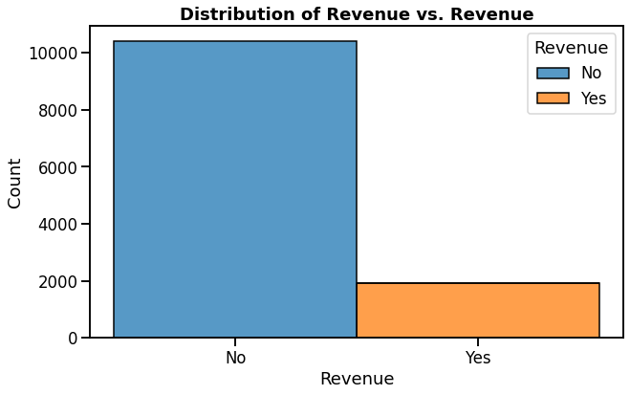
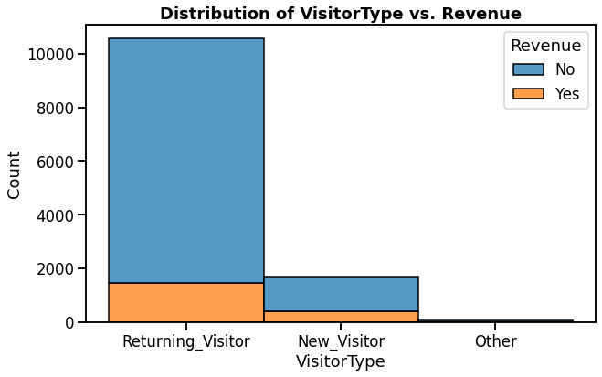
Exploratory Analysis
Majority of sessions (85%) do not result in a purchase
Majority of sessions (85%) are return customers

Slide 6
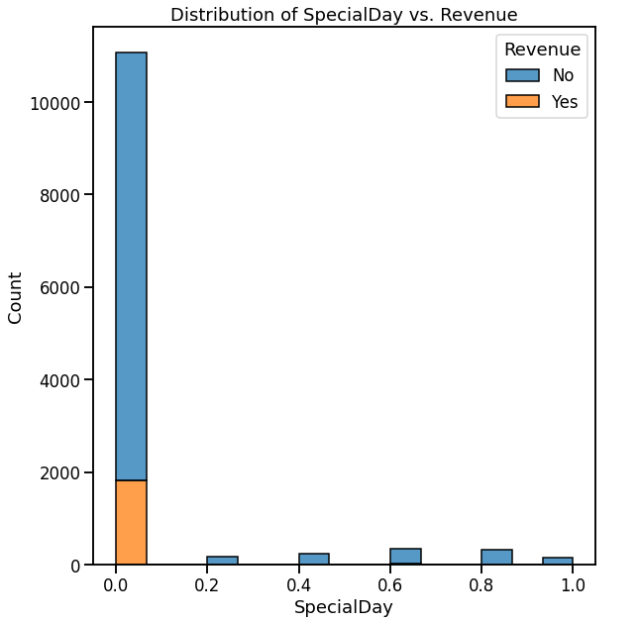
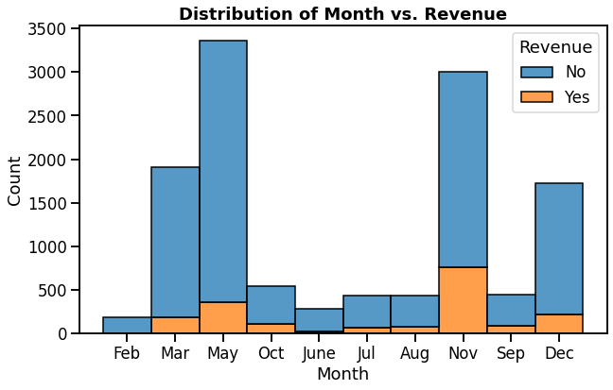
Exploratory Analysis
Peak months
March
May
Nov
Dec
Large Majority of sessions occur near a “Special DAY”

Slide 7
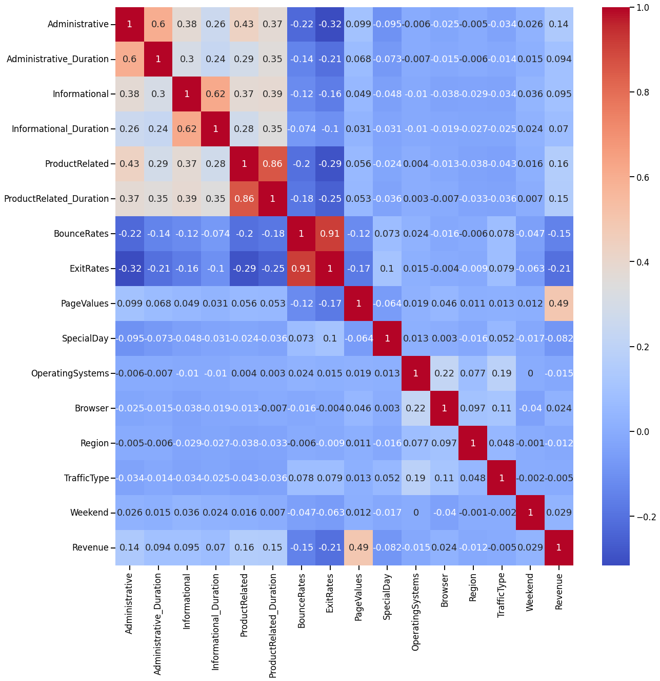
Exploratory Analysis
Google analytics features appear to have largest correlation with outcome of sessions
Page Values (positive/moderate)
Exit Rate (negative/weak)
Bounce Rates (negative/weak)

Slide 8
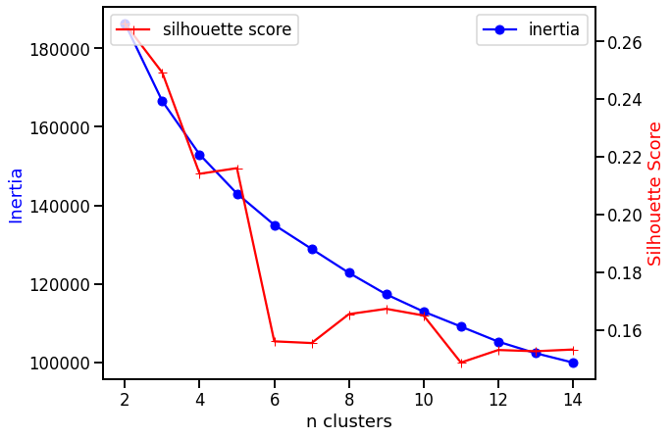
Customer Segmentation
Method
All columns scaled and encoded
Kmeans cluster method used
5 clusters chosen
Number of clusters chosen based on
inertia
silhouette score

Slide 9
Data Summary
Majority of sessions (85%) do not result in a purchase
Majority of sessions (85%) are return customers

Slide 10
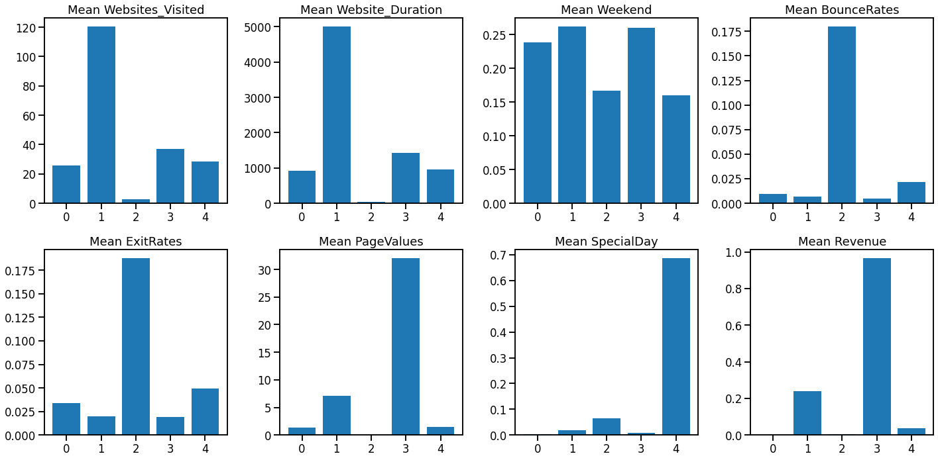
Customer Segmentation
Cluster 1 – Researchers
1160 Members (9%)
Visit the most sites
Spend the most amount of time on these sites
23% of sessions result in purchases

Slide 11
Customer Segmentation
Cluster 3 – The Buyers
1651 Members (13%)
Visit a moderate amount of sites
Spend a moderate amount of time
96% of sessions result in purchases

Slide 12
Customer Segmentation
Cluster 0 – The Almost Buyers
7681 Members (62%)
Most populous class
Similar browsing habits as buyers
Slightly less sites visited
Slightly less time spent
0% of sessions result in purchases

Slide 13
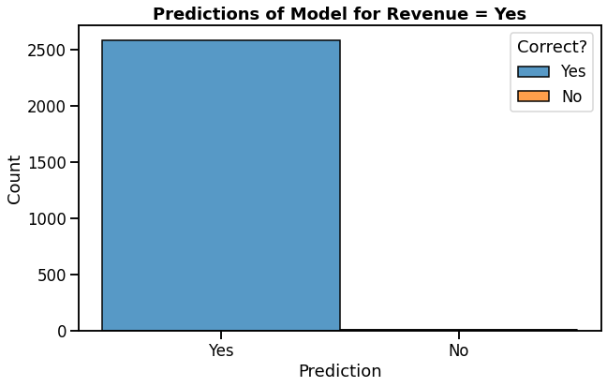
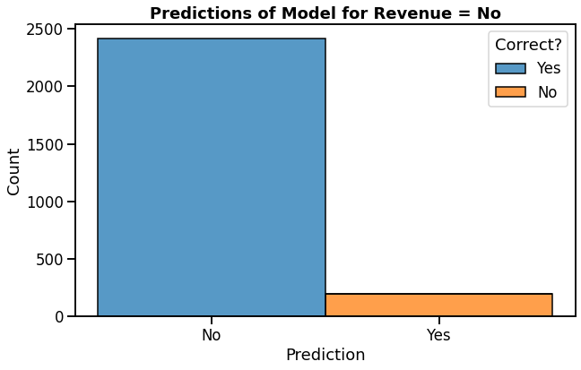
Modeling
Random Forest Model can predict online sessions that result in purchase with 99% accuracy
15% of sessions
Sessions with predicted sales can be ignored, as they are already resulting in revenue
Random Forest Model can predict online sessions that do not result in purchase with 97% accuracy
85% of sessions
Online marketing team should focus on these sessions to boost revenue
Most attention should be given to members of cluster 0 (almost buyers)
How to increase engagement time
Targeted adds
Recommended items

Slide 14
Thank You!
https://github.com/brock-ricker/Online-Shoppers-Purchasing-Intent

